Slide 1
Hierarchies & Filters
MUKESH KUMAR

Slide 2
AGENDA
Creating Hierarchies
Drill Down
Filters
Drill Thru

Slide 3
Creating Hierarchies

Slide 4
Exploring Hierarchies and Drill Options in Power BI
Creating Hierarchies
Group related fields (like Year > Month > Day) for easy navigation and drill-down in visuals.
Drill Down Options
Click into a visual to move from summarized to detailed levels (e.g., from Year to Month).
Expand and Show
Expand one level at a time or show all hierarchy levels together for broader context.

Slide 5
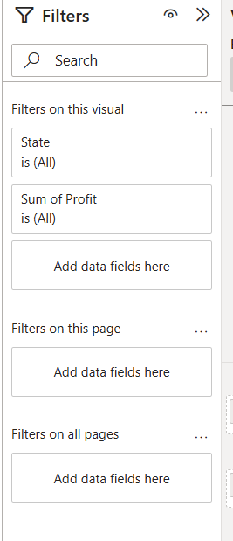
Filters
Apply filters at different scopes:
  Visual filter: affects one chart
  Page filter: affects all visuals on the page
  Report filter: applies across all pages

Slide 6
Drill Thru Reports
Drillthrough pages let you right-click a value in a chart and open a new page showing detailed data just for that value.

